Slide 1
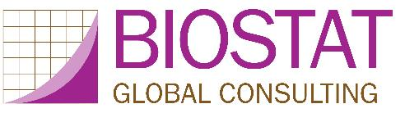
Organ Pipe Plots for Clustered Datasets
Visualize Disparities in Cluster-Level Coverage
Mary Prier & Dale Rhoda
Stata Conference ● Columbus, OH ● July 19, 2018
Notes:
Abstract: Leo Tolstoy is famous for his novels and less well known for his ideas on survey data analysis. Concerning estimated proportions, he is said to have written: Covered strata are all alike; every poorly covered stratum is poorly covered in its own way. I describe a new command to make what we call organ pipe plots to visualize heterogeneity in binary outcomes in clustered data. The plots were conceived for vaccination coverage surveys, but they are helpful in a wide variety of contexts. Imagine a survey where only 50% of sampled children are found to be vaccinated. Different programmatic responses would be appropriate if the vaccinated include all the children in half the clusters versus half the children in all the clusters. These plots have been used to identify neighborhoods that were surreptitiously and intentionally skipped over during vaccination campaigns. The talk will demonstrate the command and discuss similarities with Pareto plots from quality control and a visual connection to the intracluster correlation coefficient (ICC). Note that the ICC shares a connection to anarcho-pacifistic ideas in Tolstoy’s later novels: many students mention them … but few can describe them clearly.

Slide 2
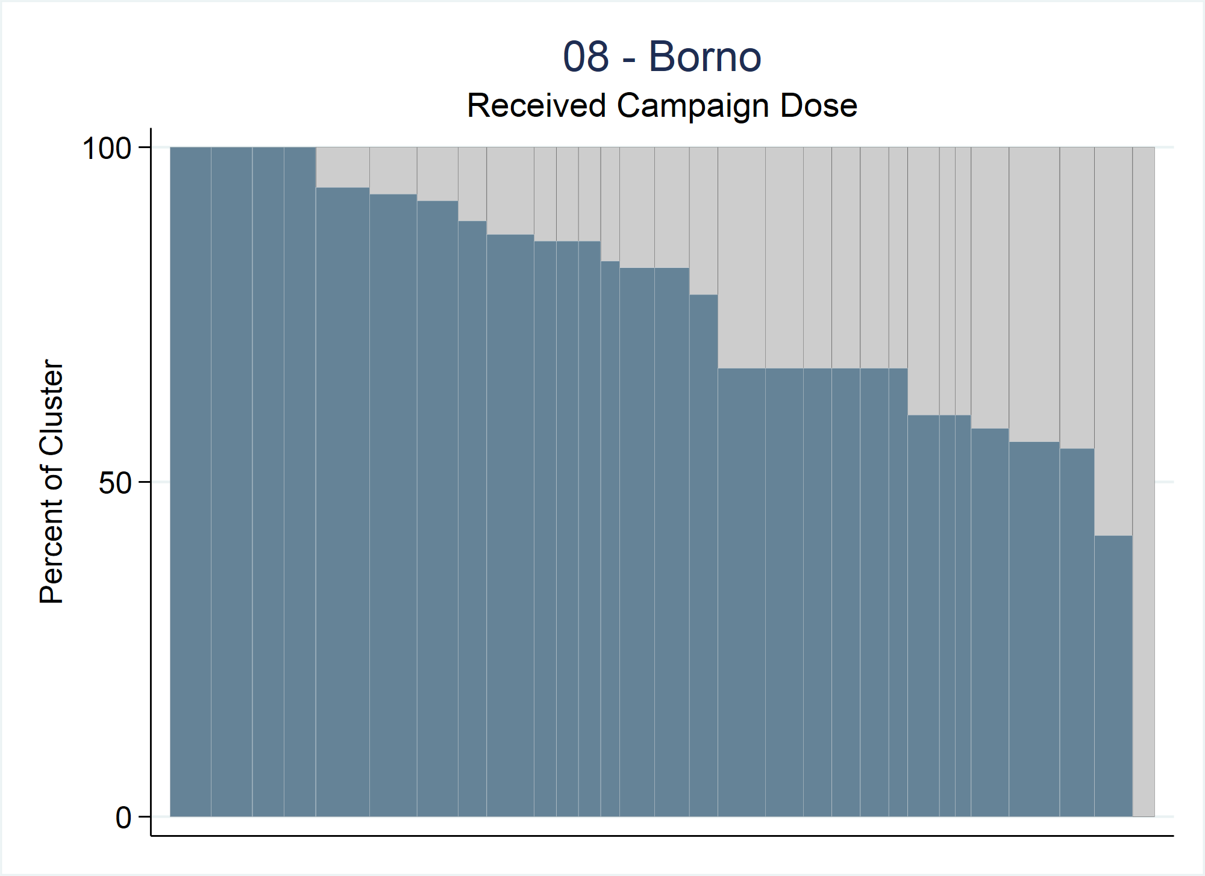
Organ Pipe Plot
Vertical bar chart summarizing a binary outcome in cluster survey data
Visualize heterogeneity among clusters
Notes:
An organ pipe plot is a special type of vertical bar chart. It plots a binary outcome in cluster survey data.
Each cluster is represented with a vertical bar.
The shaded portion of the bar represents the proportion of respondents in that cluster whose value of the binary variable is 1.
Clusters with the highest proportion of 1’s are shown at the left side of the plot, and coverage decreases from left to right.
These plots help people visualize heterogeneity among the clusters.
We work in the vaccination field where a value of 1 is a good thing and shaded bars are a good thing…it indicates high vaccination coverage among children…bars not shaded are a bad thing as it indicates children are not vaccinated and susceptible to disease. For the purpose of this talk we will be thinking that values of 1 are good thing, but the logic can easily be reversed if that’s what your data calls for.
This organ pipe plot is from a recent vaccination campaign in Nigeria. It shows the proportion of children who received a measles dose during the campaign in the state of Borno. Note that there are 30 bars in this plot representing the 30 clusters sampled in Borno.

Slide 3
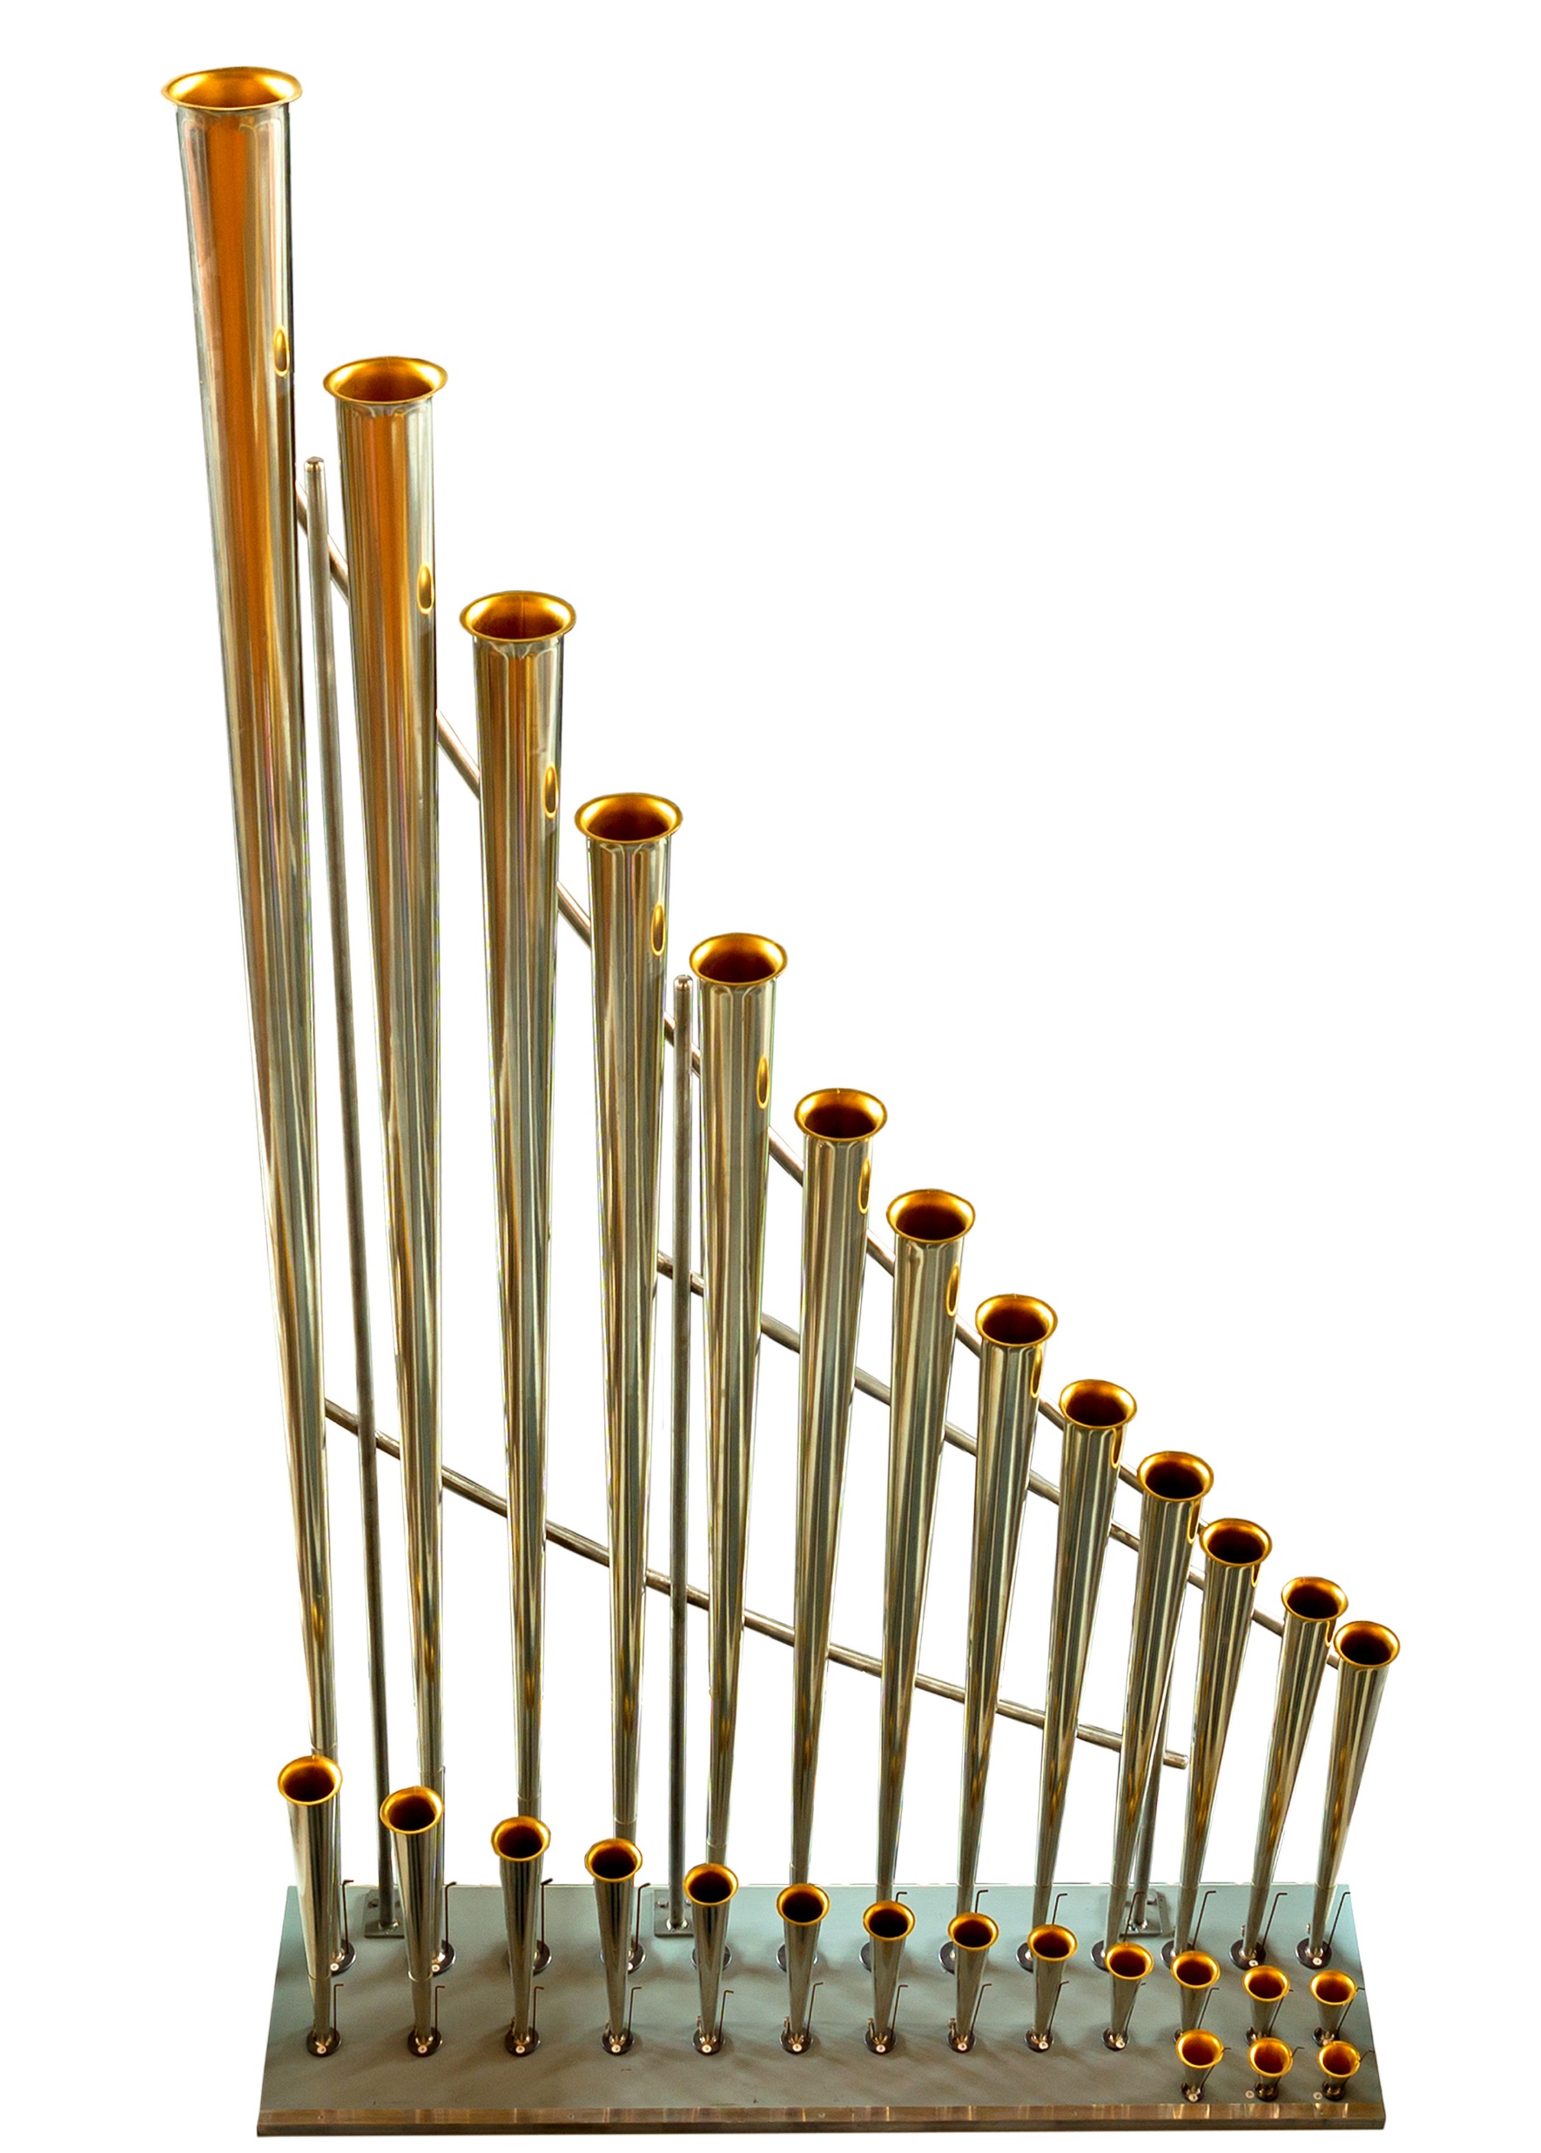
Organ Pipe Plot - Background
Name was inspired by pipes like these
We developed these plots for vaccination coverage surveys
Can be helpful in any type of cluster survey with binary outcomes
“OP Plot” for short

Slide 4
Summary Table Example
Stratum ID | # of Clusters | Total Sampled (N) | Estimated Vaccination Coverage | CI Half-Width
1 | 16 | 256 | 50% | 6.1%
2 | 16 | 256 | 50% | 13.2%
3 | 16 | 256 | 50% | 19.6%
4 | 16 | 256 | 50% | 24.5%
Notes:
Imagine you see this table in a final report from a stratified cluster survey. There were 4 strata, each with 16 clusters, and each cluster sampled 16 respondents for a total of 256 total sampled respondents in each stratum.
The estimated vaccination coverage for each stratum was 50%, yet the CI widths vary greatly.
There is a whole story behind the 50%, and these plots help drill down to what’s going on within each stratum.

Slide 5
Notes:
Here are the 4 corresponding OP plots.
The upper left OP plot shows a stratum in which 50% of the sampled children in each cluster are vaccinated while 50% are not.
The upper right OP plot shows a stratum at the other end of the spectrum…where half of the clusters have 100% of sampled children vaccinated and the other half found 0% vaccinated.
The bottom two plots show examples between these two extremes yet also have 50% sample coverage.
Different programmatic responses would be appropriate for each of these stratum. For example, clusters where 0% of the sampled children are vaccinated would likely be first priority, followed by clusters who fell below a desired threshold for campaign success.
These plots help us understand the variability in cluster-level coverage which helps evaluate vaccination program performance and what problems there may be and where.

Slide 6
Identify Clusters with Alarmingly Low Coverage
OP plots are also useful for identifying clusters with alarmingly low coverage…these are the bars with little to no shading
OP plots can be generated before survey weights are ready
This results in unweighted plots
Plots generated with weights are weighted plots (see slides on Bar Widths)
Finding these clusters with low coverage before the survey is complete could provide immediate actionable information from the survey

Slide 7
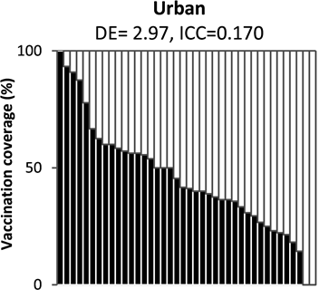
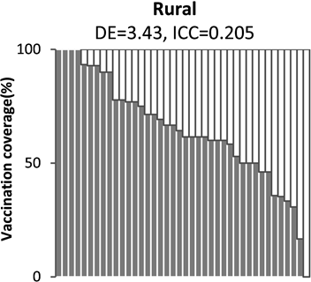
Jharkhand, India Measles Vaccination Campaign 2012
Scobie HM, Ray A, Routray S, Bose A, Bahl S, Sosler S, et al. (2015) Cluster Survey Evaluation of a Measles Vaccination Campaign in Jharkhand, India, 2012. PLoS ONE 10(5): e0127105. https://doi.org/10.1371/journal.pone.0127105
Notes:
For example…Jharkhand, India Measles Vaccination Campaign in 2012.
(A vaccination campaign is when a particular vaccine is given (in this case, measles) to a large population (in this study children 9mo-10years) in a short amount of time. These may be done if there has been a recent outbreak or if a new vaccine has been added to the country’s vaccination schedule.)
These two OP plots were used in the final report, and show coverage broken out by urban & rural areas.
Notice there are two clusters in the urban plot that found 0% sampled children vaccinated. Using other variables in the survey dataset, it was found that the majority of the reasons why children were not vaccinated was because the caregiver was unaware of the campaign. This gives insight to program and survey leaders.
The rural OP plot shows one cluster with 0% sampled children vaccinated. The majority of reasons why not vaccinated for this cluster was because the vaccination team did not come to the appointed site, they intentionally skipped over that cluster. Knowing this, program and survey leaders could learn why workers did this and if they want them to go back and offer the vaccine or not.

Slide 8
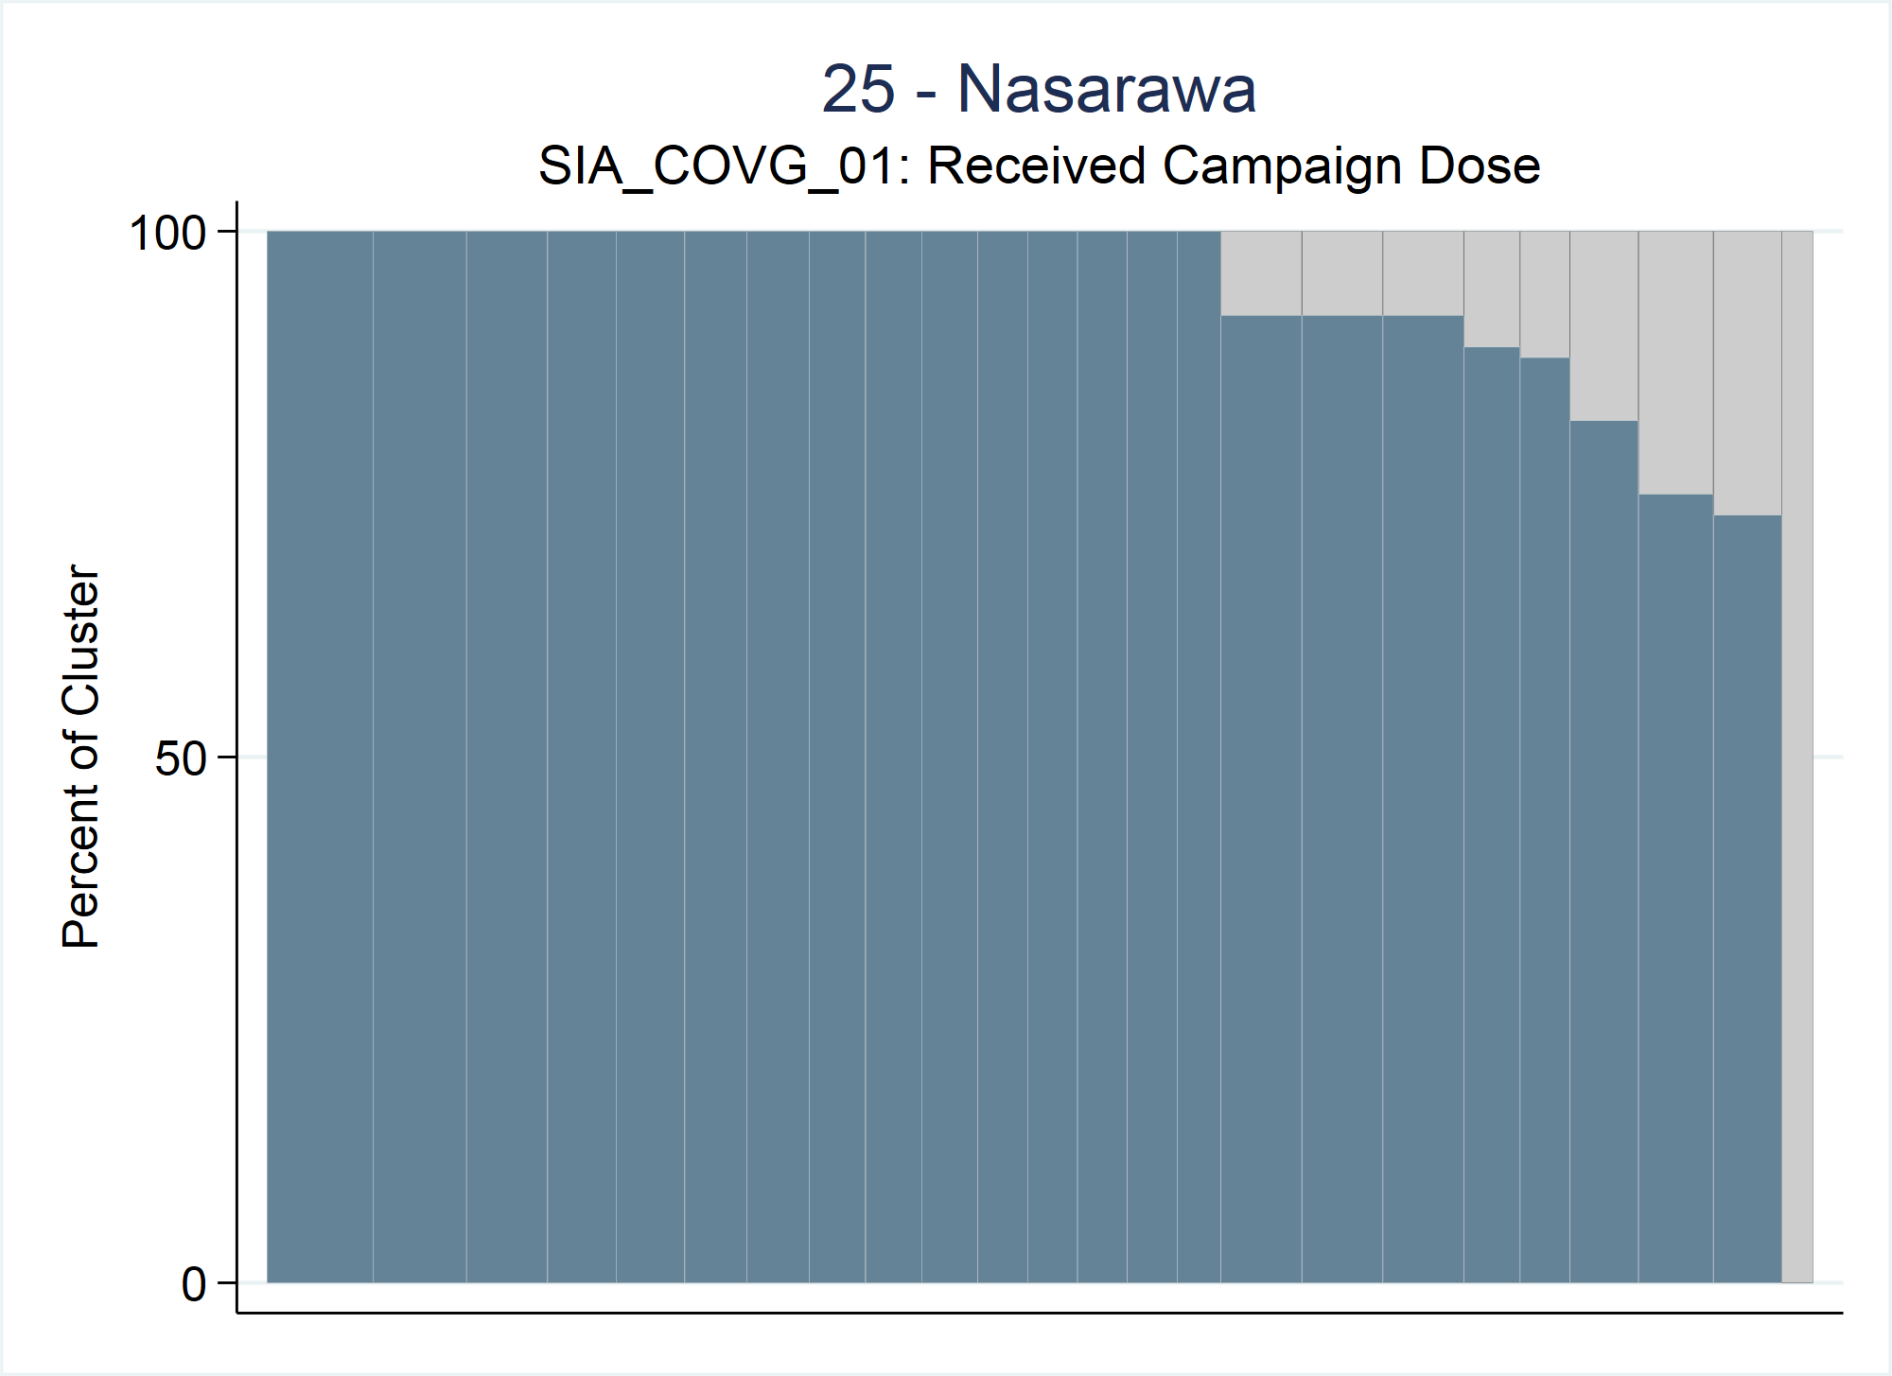
Nigeria Measles Vaccination Campaign 2017
Nasarawa, Nigeria had 248 respondents from 24 clusters
All reasons why child not vaccinated because there was a crisis as the town was attacked and they had to flee the area
Notes:
Another example of how OP plots can be helpful finding clusters with surprisingly low coverage comes from the Nigeria measles vaccination campaign in 2017.
The state of Nasarawa had high coverage for nearly all the clusters except one, where 0% of sampled children were found to be vaccinated.
All sampled caregivers cited that the town had been attacked and they were forced to flee the area during the time the campaign was set to occur.
With this information, program and survey leaders could send another vaccination team to that cluster after peace has been restored.

Slide 9
Organ Pipe Plot – Stata Command
opplot yvar [if] [in] , CLUSTVAR(varname)
Notes:
To make an organ pipe plot, specify the opplot command. There are two required inputs: yvar and CLUSTVAR.
yvar: Binary variable taking values 0, 1, or missing (.); Only respondents whose values of yvar==1 are included in the numerator; All respondents are included in denominator (even those with a missing value)
CLUSTVAR(varname): Variable that holds the cluster ID

Slide 10
Organ Pipe Plot – Stata Command
opplot yvar [if] [in] , CLUSTVAR(varname)
[ STRATVAR(varname) STRATUM(string)
Notes:
Survey related variables:
STRATVAR(varname): Opplot shows data for one stratum per plot. If dataset contains data for more than 1 stratum, specify the stratum ID variable and use the stratum option.
STRATUM(string): The value of STRATVAR for which to make the plot.

Slide 11
Organ Pipe Plot – Stata Command
opplot yvar [if] [in] , CLUSTVAR(varname)
[ STRATVAR(varname) STRATUM(string) WEIGHTvar(varname) EQUALWIDTH
Notes:
There are three choices for the bar widths. Either the WEIGHTvar or EQUALWIDTH option is specified or neither are specified.

Slide 12
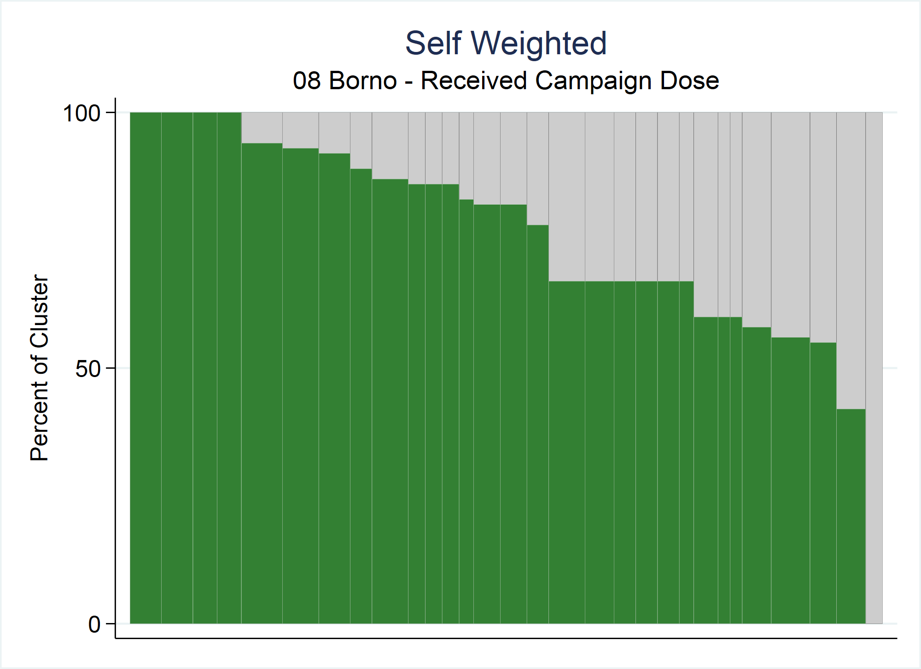
Notes:
If neither WEIGTHvar or EQUALWIDTH options are specified, then the data are self-weighted (assumed to be equal) and the shaded proportion of the plot is equal to the unweighted sample coverage.

Slide 13
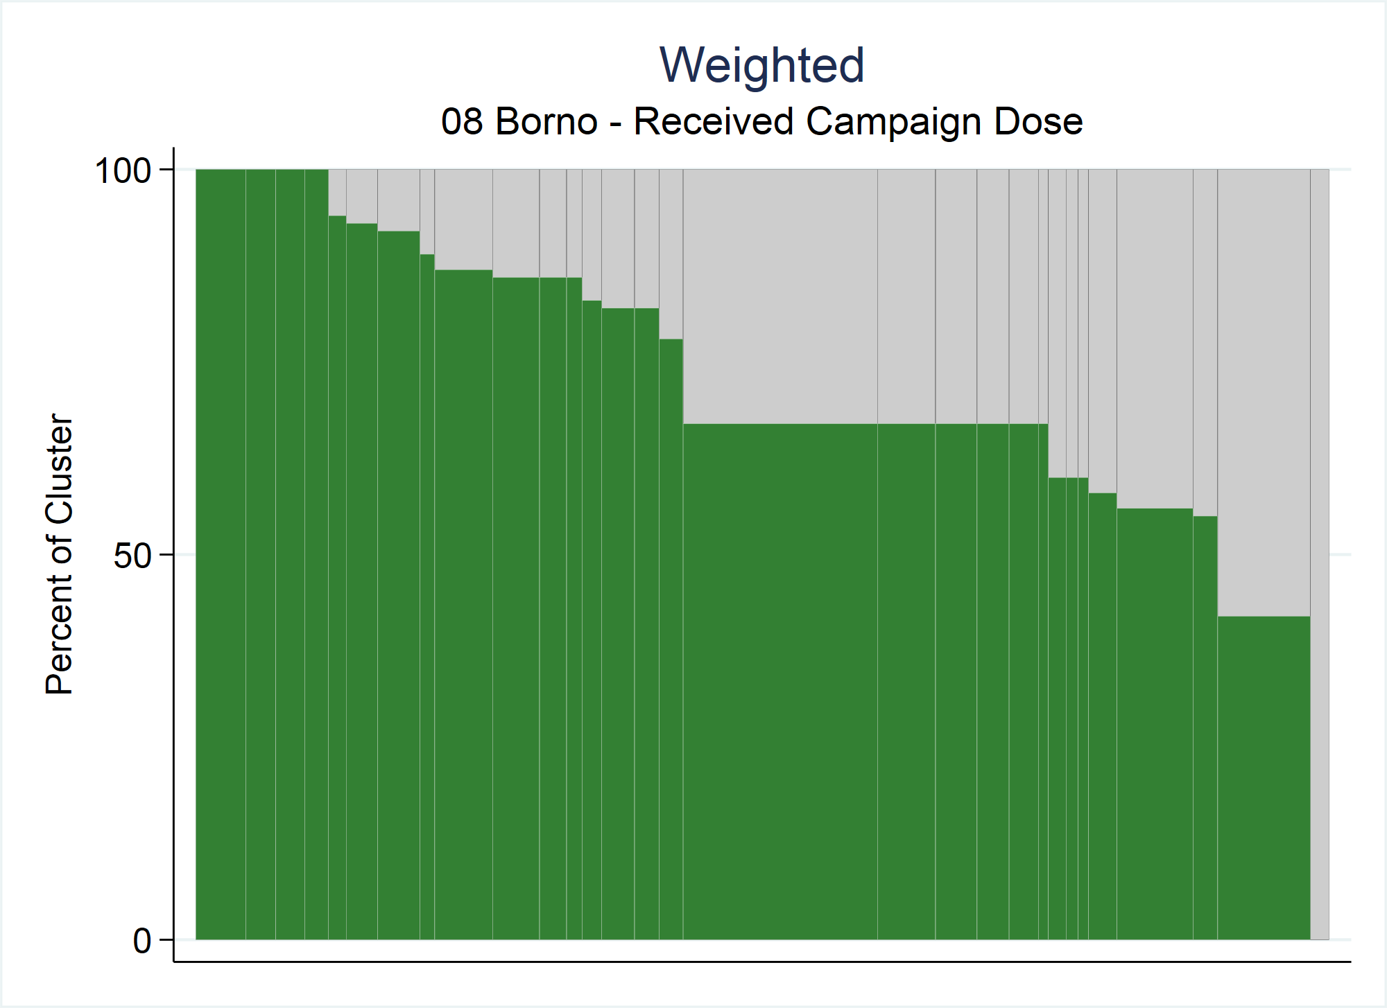
Notes:
If the WEIGHTvar(varname) option is specified then the user points to the variable in the dataset that holds the survey weight.
Weighted OP plots are the preferred method for 2 reasons:
The shaded proportion represents the weighted sample coverage estimate and
the width of each bar represents that cluster’s weighted proportion of the population
Downsides…we don’t know how many kids were sampled in each cluster & probably can’t label the bars clearly.

Slide 14
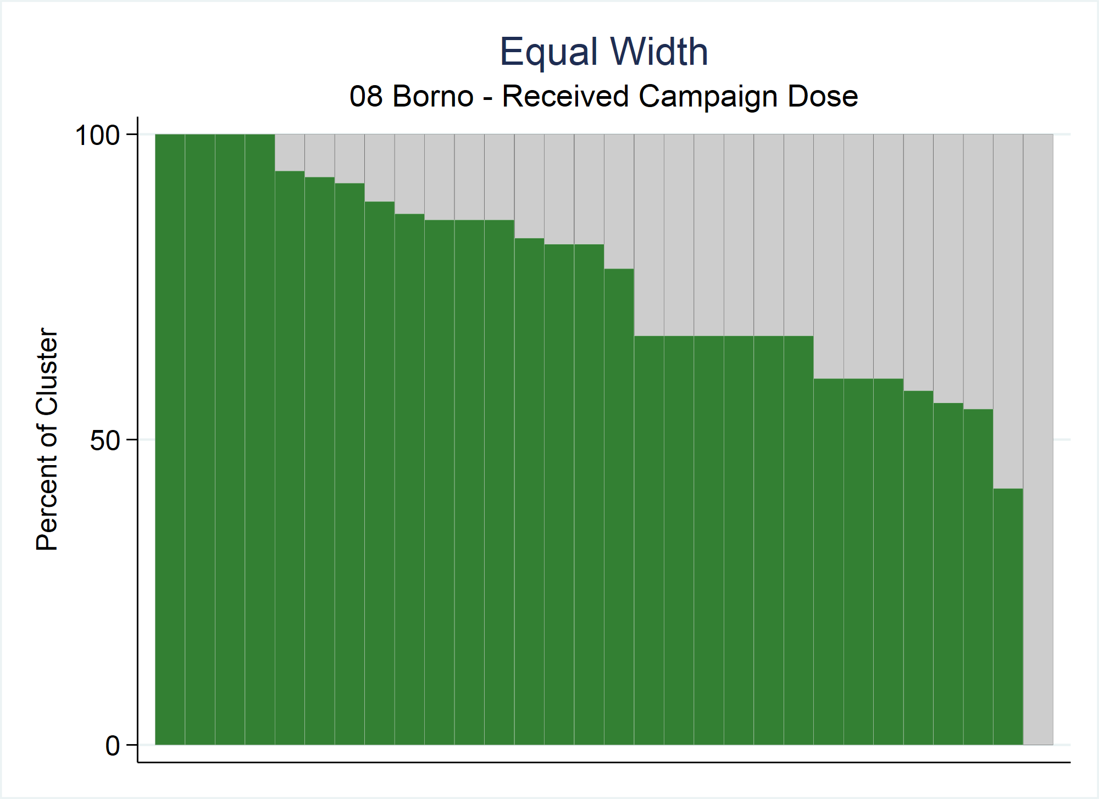
Notes:
If the EQUALWIDTH option is specified, then all the bars will appear with equal width, regardless of the number of respondents in the cluster and regardless of the values of the weightvar.
Regardless which bar width option is used, the bar height will always be the same because the shaded proportion of each bar represents the proportion of respondents in that cluster whose value of the binary variable is 1.

Slide 15
Organ Pipe Plot – Bar Widths
Focus: Cluster ID=236; N=12
Bar height = 67%
Bar width = 3.9
Bar height = 67%
Bar width = 17.2
Bar height = 67%
Bar width = 3.3
Notes:
Compare all three of the OP plots from the previous slides at once…Notice the bar heights are all the same for each plot, 67%, but the bar widths all vary.

Slide 16
Organ Pipe Plot – Stata Command
opplot yvar [if] [in] , CLUSTVAR(varname)
[ STRATVAR(varname) STRATUM(string) WEIGHTvar(varname) EQUALWIDTH EXPORTSTRAtumname EXPORT(string) EXPORTWidth(integer)
Notes:
There are also options for exporting the image…

Slide 17
Organ Pipe Plot – Stata Command
opplot yvar [if] [in] , CLUSTVAR(varname)
[ STRATVAR(varname) STRATUM(string) WEIGHTvar(varname) EQUALWIDTH EXPORTSTRAtumname EXPORT(string) EXPORTWidth(integer) TWOWAY(string) TITLE(string) SUBtitle(string) FOOTnote(string) NOTE(string) XTITLE(string) YTITLE(string) XLABEL(string) YLABEL(string) SAVING(string) NAME(string) XSIZE(real) YSIZE(real)
Notes:
…as well as standard twoway options including titles, labels and sizes.

Slide 18
Organ Pipe Plot – Stata Command
opplot yvar [if] [in] , CLUSTVAR(varname)
[ STRATVAR(varname) STRATUM(string) WEIGHTvar(varname) EQUALWIDTH EXPORTSTRAtumname EXPORT(string) EXPORTWidth(integer) TWOWAY(string) TITLE(string) SUBtitle(string) FOOTnote(string) NOTE(string) XTITLE(string) YTITLE(string) XLABEL(string) YLABEL(string) SAVING(string) NAME(string) XSIZE(real) YSIZE(real) BARCOLOR1(string) BARCOLOR2(string) LINECOLOR1(string) LINECOLOR2(string)
Notes:
The user also has control of the bar and line colors of the plot.

Slide 19
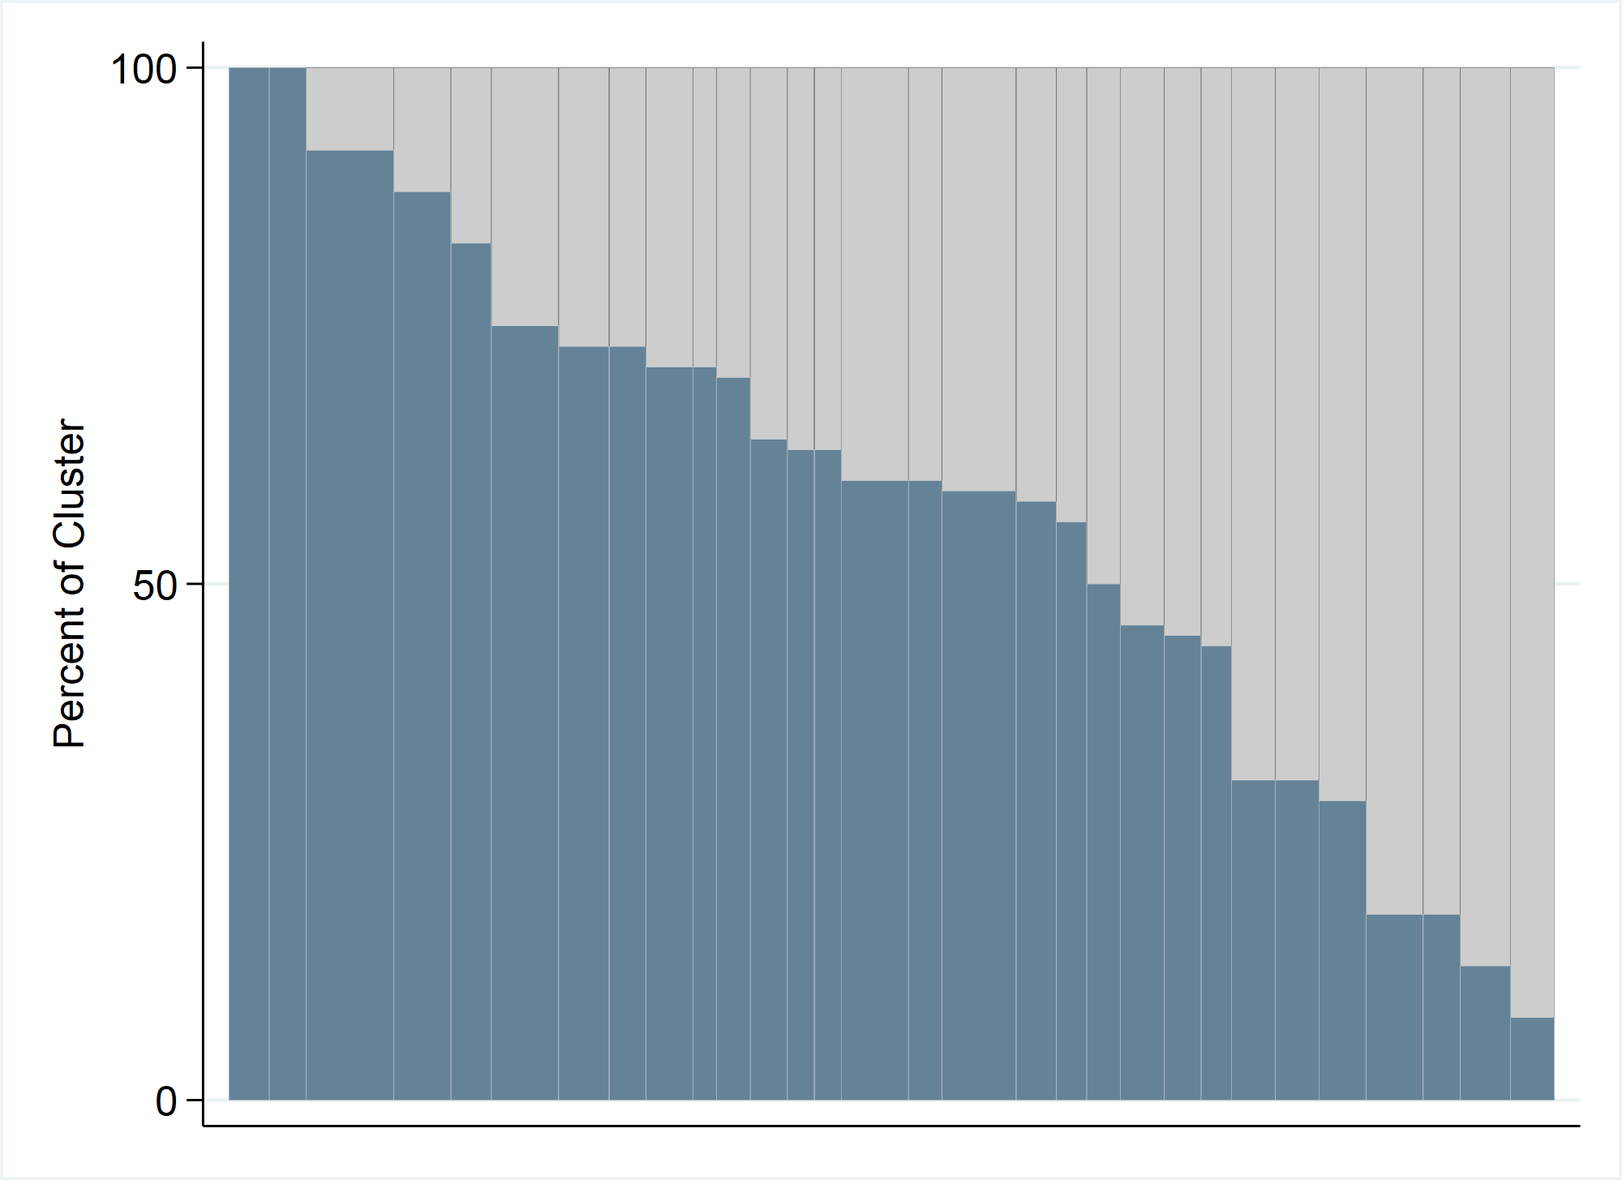
Stata Command, Optional Inputs (cont.)
BARCOLOR2(string)
LINECOLOR2(string)
BARCOLOR1(string)
LINECOLOR1(string)
Notes:
BARCOLOR1 and LINECOLOR1 correspond to the bottom bars while BARCOLOR2 and LINECOLOR2 correspond to the top bars.

Slide 20
Organ Pipe Plot – Stata Command
opplot yvar [if] [in] , CLUSTVAR(varname)
[ STRATVAR(varname) STRATUM(string) WEIGHTvar(varname) EQUALWIDTH EXPORTSTRAtumname EXPORT(string) EXPORTWidth(integer) TWOWAY(string) TITLE(string) SUBtitle(string) FOOTnote(string) NOTE(string) XTITLE(string) YTITLE(string) XLABEL(string) YLABEL(string) SAVING(string) NAME(string) XSIZE(real) YSIZE(real) BARCOLOR1(string) BARCOLOR2(string) LINECOLOR1(string) LINECOLOR2(string) SAVEDATA(string)
Notes:
Finally, the SAVEDATA(string) option saves a dataset that includes one row per bar in the plot; the left-most bar in the plot is represented by row 1 of the dataset and the right-most bar in the plot by the last row in the dataset.

Slide 21
Stata Command, SAVEDATA Optional Input
yvar | stratvar | stratum | cluster | clusterid | n_respondents | barorder | barwidth | cumulative_barwidth | barheight
got_sia_dose | stratumid | 7 | clusterid | 87 | 12 | 1 | 4.166667 | 4.166667 | 100
. | . | . | . |  |  |  |  |  | .
. | . | . | . |  |  |  |  |  | .
. | . | . | . |  |  |  |  |  | .
got_sia_dose | stratumid | 7 | clusterid | 76 | 5 | 17 | 1.736111 | 51.73611 | 100
got_sia_dose | stratumid | 7 | clusterid | 82 | 11 | 18 | 3.819444 | 55.55556 | 91
got_sia_dose | stratumid | 7 | clusterid | 67 | 11 | 19 | 3.819444 | 59.375 | 82
got_sia_dose | stratumid | 7 | clusterid | 73 | 15 | 20 | 5.208333 | 64.58334 | 80
got_sia_dose | stratumid | 7 | clusterid | 74 | 10 | 21 | 3.472222 | 68.05556 | 80
got_sia_dose | stratumid | 7 | clusterid | 75 | 10 | 22 | 3.472222 | 71.52778 | 80
got_sia_dose | stratumid | 7 | clusterid | 69 | 5 | 23 | 1.736111 | 73.26389 | 80
got_sia_dose | stratumid | 7 | clusterid | 70 | 9 | 24 | 3.125 | 76.38889 | 78
got_sia_dose | stratumid | 7 | clusterid | 64 | 8 | 25 | 2.777778 | 79.16666 | 75
got_sia_dose | stratumid | 7 | clusterid | 68 | 13 | 26 | 4.513889 | 83.68056 | 69
got_sia_dose | stratumid | 7 | clusterid | 66 | 12 | 27 | 4.166667 | 87.84722 | 58
got_sia_dose | stratumid | 7 | clusterid | 71 | 7 | 28 | 2.430556 | 90.27778 | 57
got_sia_dose | stratumid | 7 | clusterid | 81 | 10 | 29 | 3.472222 | 93.75 | 50
got_sia_dose | stratumid | 7 | clusterid | 77 | 18 | 30 | 6.25 | 100 | 11
Notes:
Here is an example of the dataset that is saved…
The dataset contains descriptive variables about the bars including the height and width, but more importantly include the clusterid and the n_respondents.
This dataset is useful for identifying the cluster ID for bars that show surprisingly low coverage. In this example, the last bar in the plot (plot not shown) had a bar height of 11%...meaning 11% of the children sampled were found to be vaccinated. We can see that this bar corresponds to cluster ID=77 and n=18 children were sampled.

Slide 22
Organ Pipe Plot – Stata Command
opplot yvar [if] [in] , CLUSTVAR(varname)
[ STRATVAR(varname) STRATUM(string) WEIGHTvar(varname) EQUALWIDTH EXPORTSTRAtumname EXPORT(string) EXPORTWidth(integer) TWOWAY(string) TITLE(string) SUBtitle(string) FOOTnote(string) NOTE(string) XTITLE(string) YTITLE(string) XLABEL(string) YLABEL(string) SAVING(string) NAME(string) XSIZE(real) YSIZE(real) BARCOLOR1(string) BARCOLOR2(string) LINECOLOR1(string) LINECOLOR2(string) SAVEDATA(string) PLOTN
Notes:
If PLOTN is specified, the plot will include a second y-axis and a line showing the number of respondents per cluster.

Slide 23
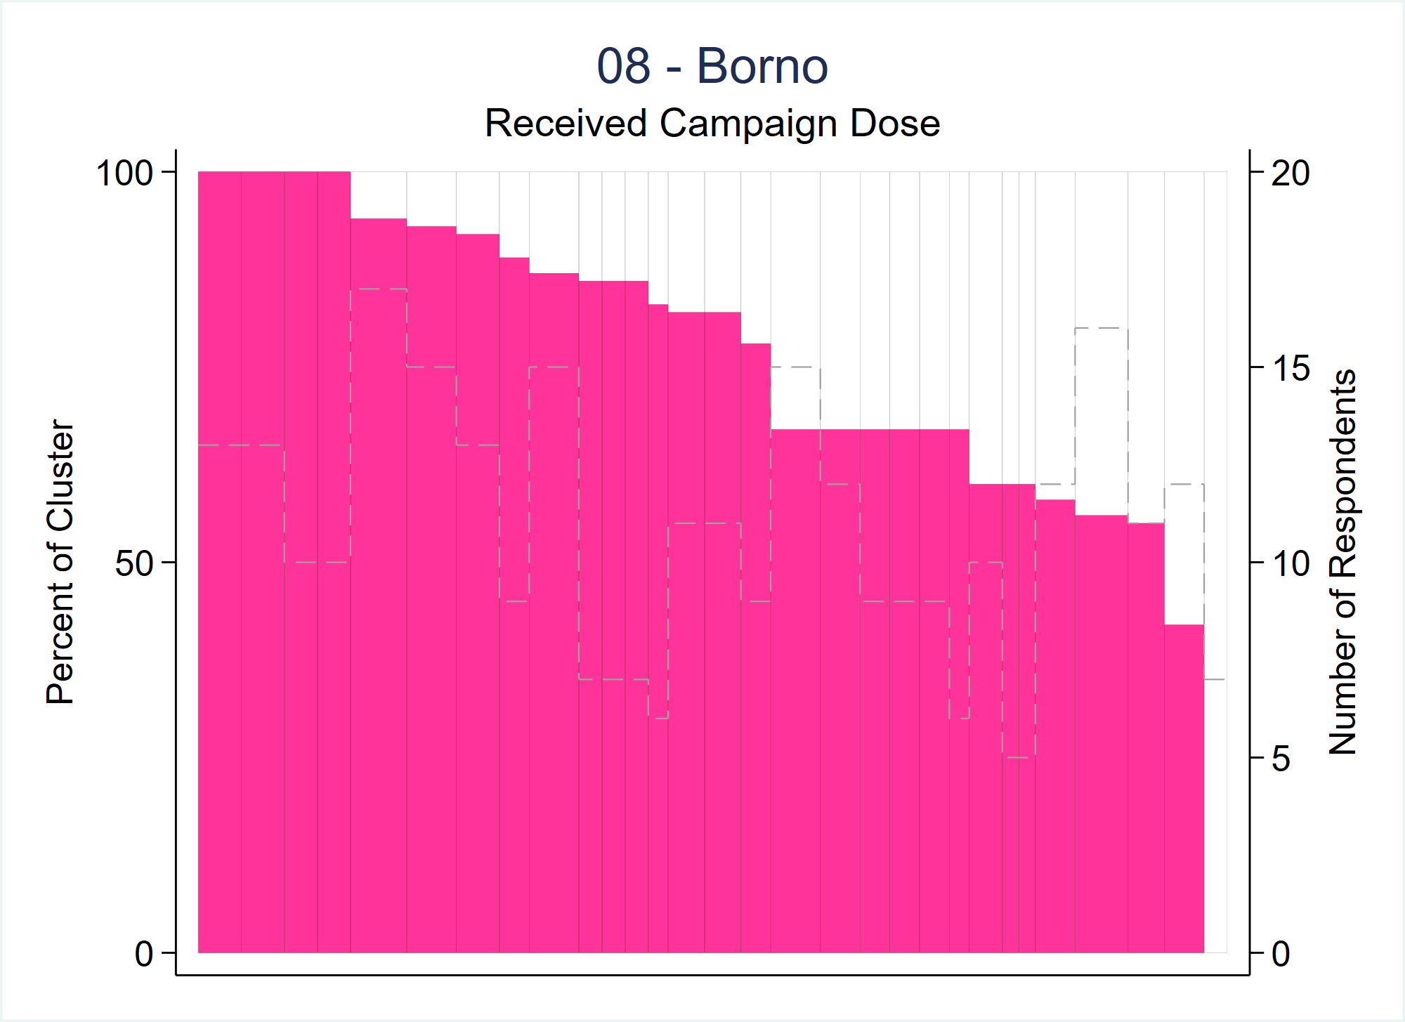
Stata Command, PLOTN Optional Input
Second y-axis
Dashed line shows the number of respondents in each cluster

Slide 24
Organ Pipe Plot – Stata Command
opplot yvar [if] [in] , CLUSTVAR(varname)
[ STRATVAR(varname) STRATUM(string) WEIGHTvar(varname) EQUALWIDTH EXPORTSTRAtumname EXPORT(string) EXPORTWidth(integer) TWOWAY(string) TITLE(string) SUBtitle(string) FOOTnote(string) NOTE(string) XTITLE(string) YTITLE(string) XLABEL(string) YLABEL(string) SAVING(string) NAME(string) XSIZE(real) YSIZE(real) BARCOLOR1(string) BARCOLOR2(string) LINECOLOR1(string) LINECOLOR2(string) SAVEDATA(string) PLOTN NLINEColor(string) NLINEWidth(string) NLINEPattern(string) YTITLE2(string) YROUND2(integer 5) ]
Notes:
User may specify the properties of the “plotn” line and of its axis title & labels using the options listed.
YROUND2(integer 5) affects the labels on the second y-axis if the user specifies the PLOTN option.
The scale will run from 0 up to the (maximum number of respondents in a cluster plus one) rounded up to the next multiple of YROUND2.
Default is to round up to the next multiple of 5.

Slide 25
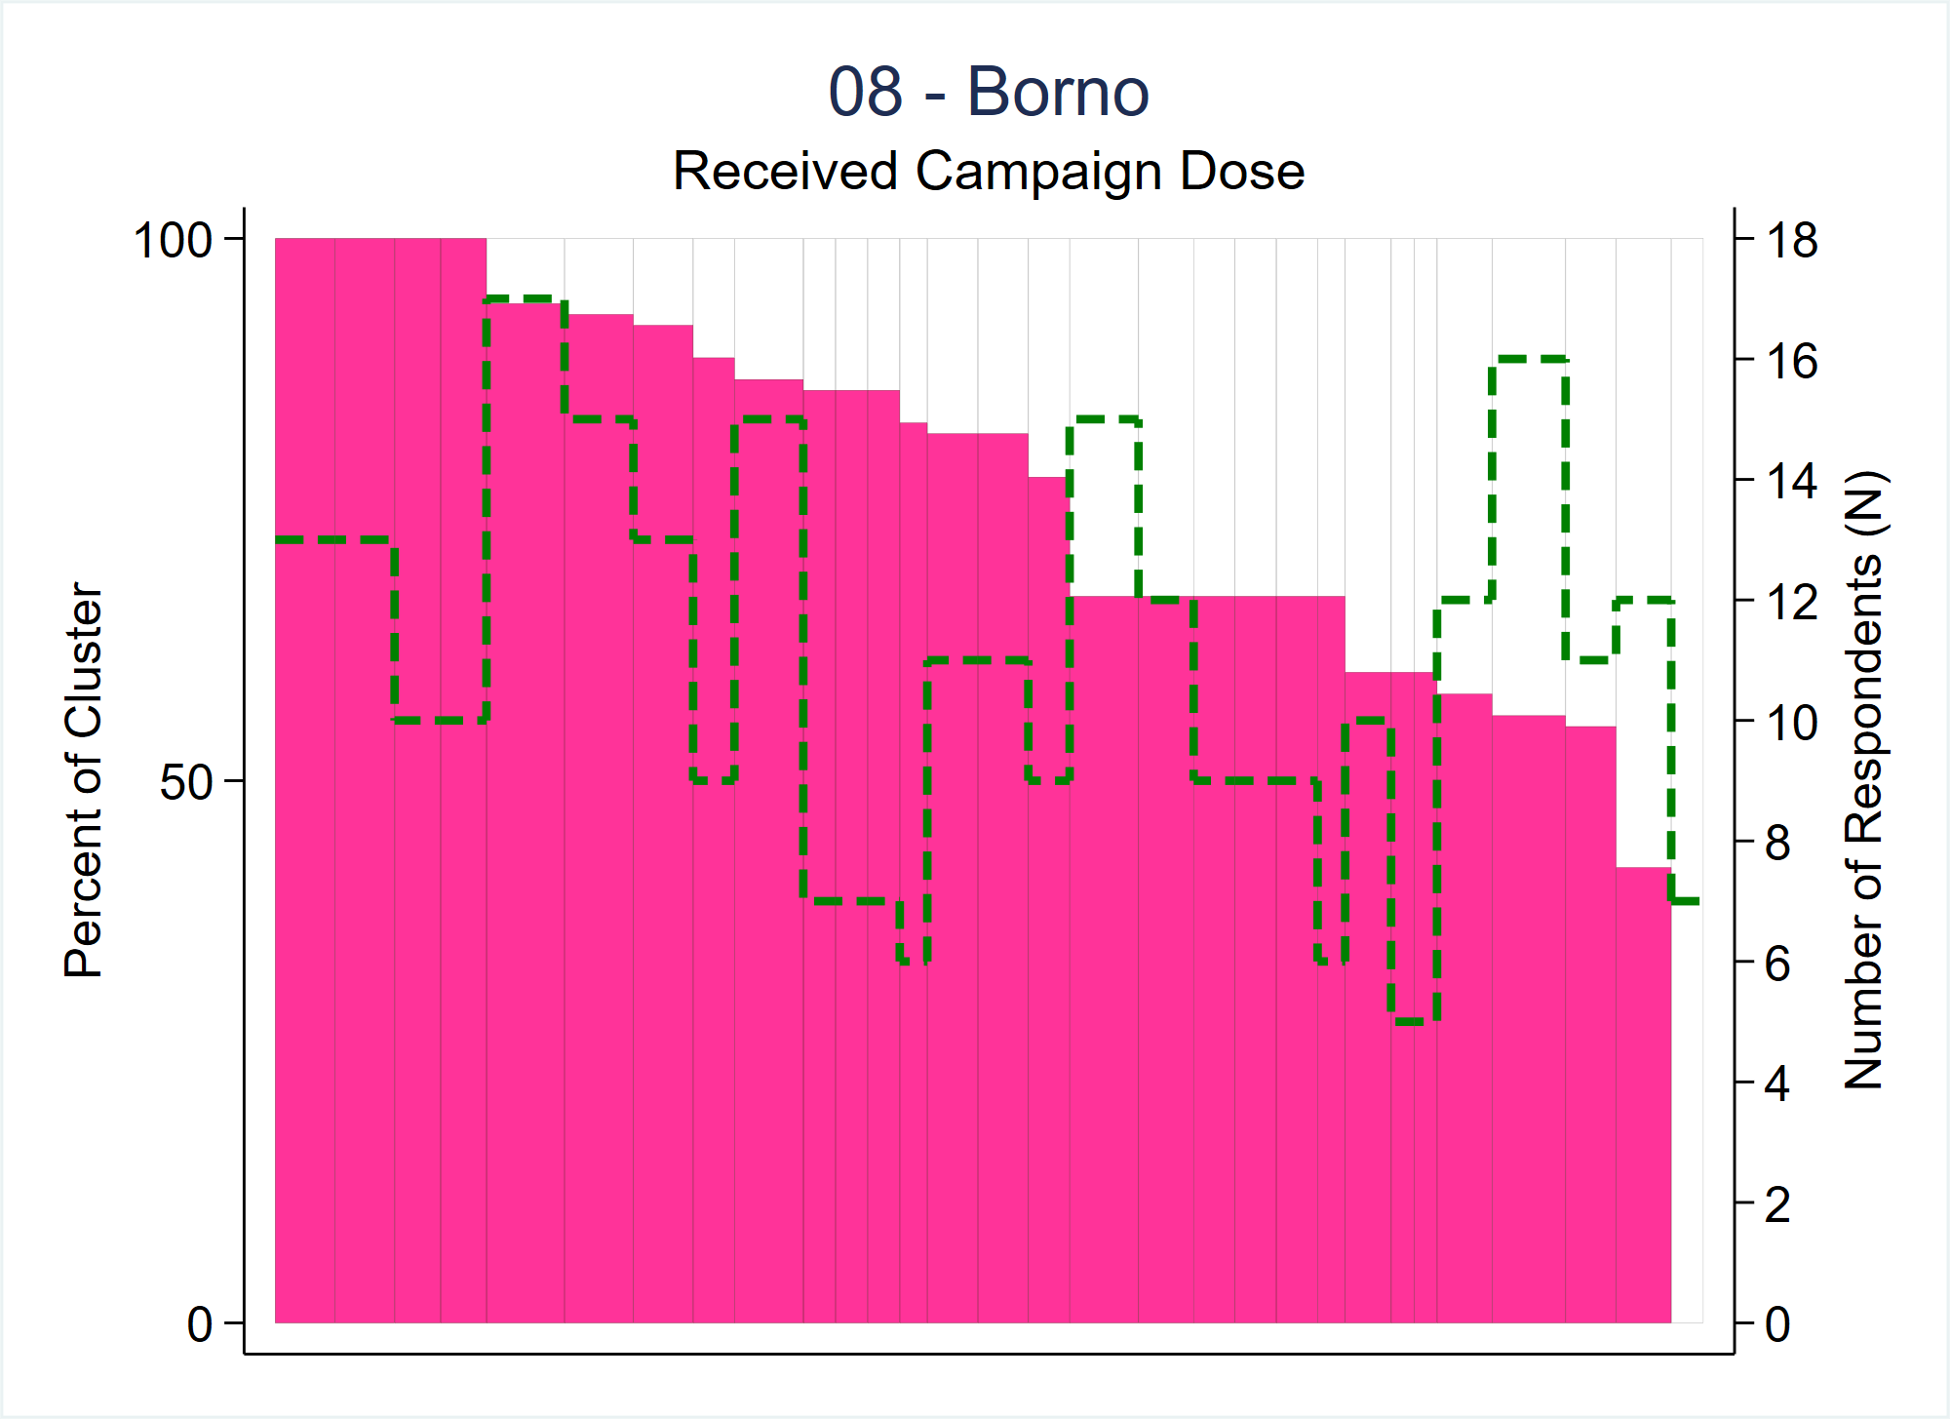
Stata Command, PLOTN Optional Input Cont.
Specified different axis title
& increment N by 2 (instead of the default 5)
Specified different line color, width & pattern

Slide 26
Notes about PLOTN
The dashed line helps show the heterogeneity of N in the stratum
Some clusters with low coverage may not be too alarming if N is very small
Consider making the opplot first without the PLOTN option, and then add it if there are clusters with low (or no) coverage
The sample size for each cluster can be checked either by the SAVEDATA or PLOTN options

Slide 27
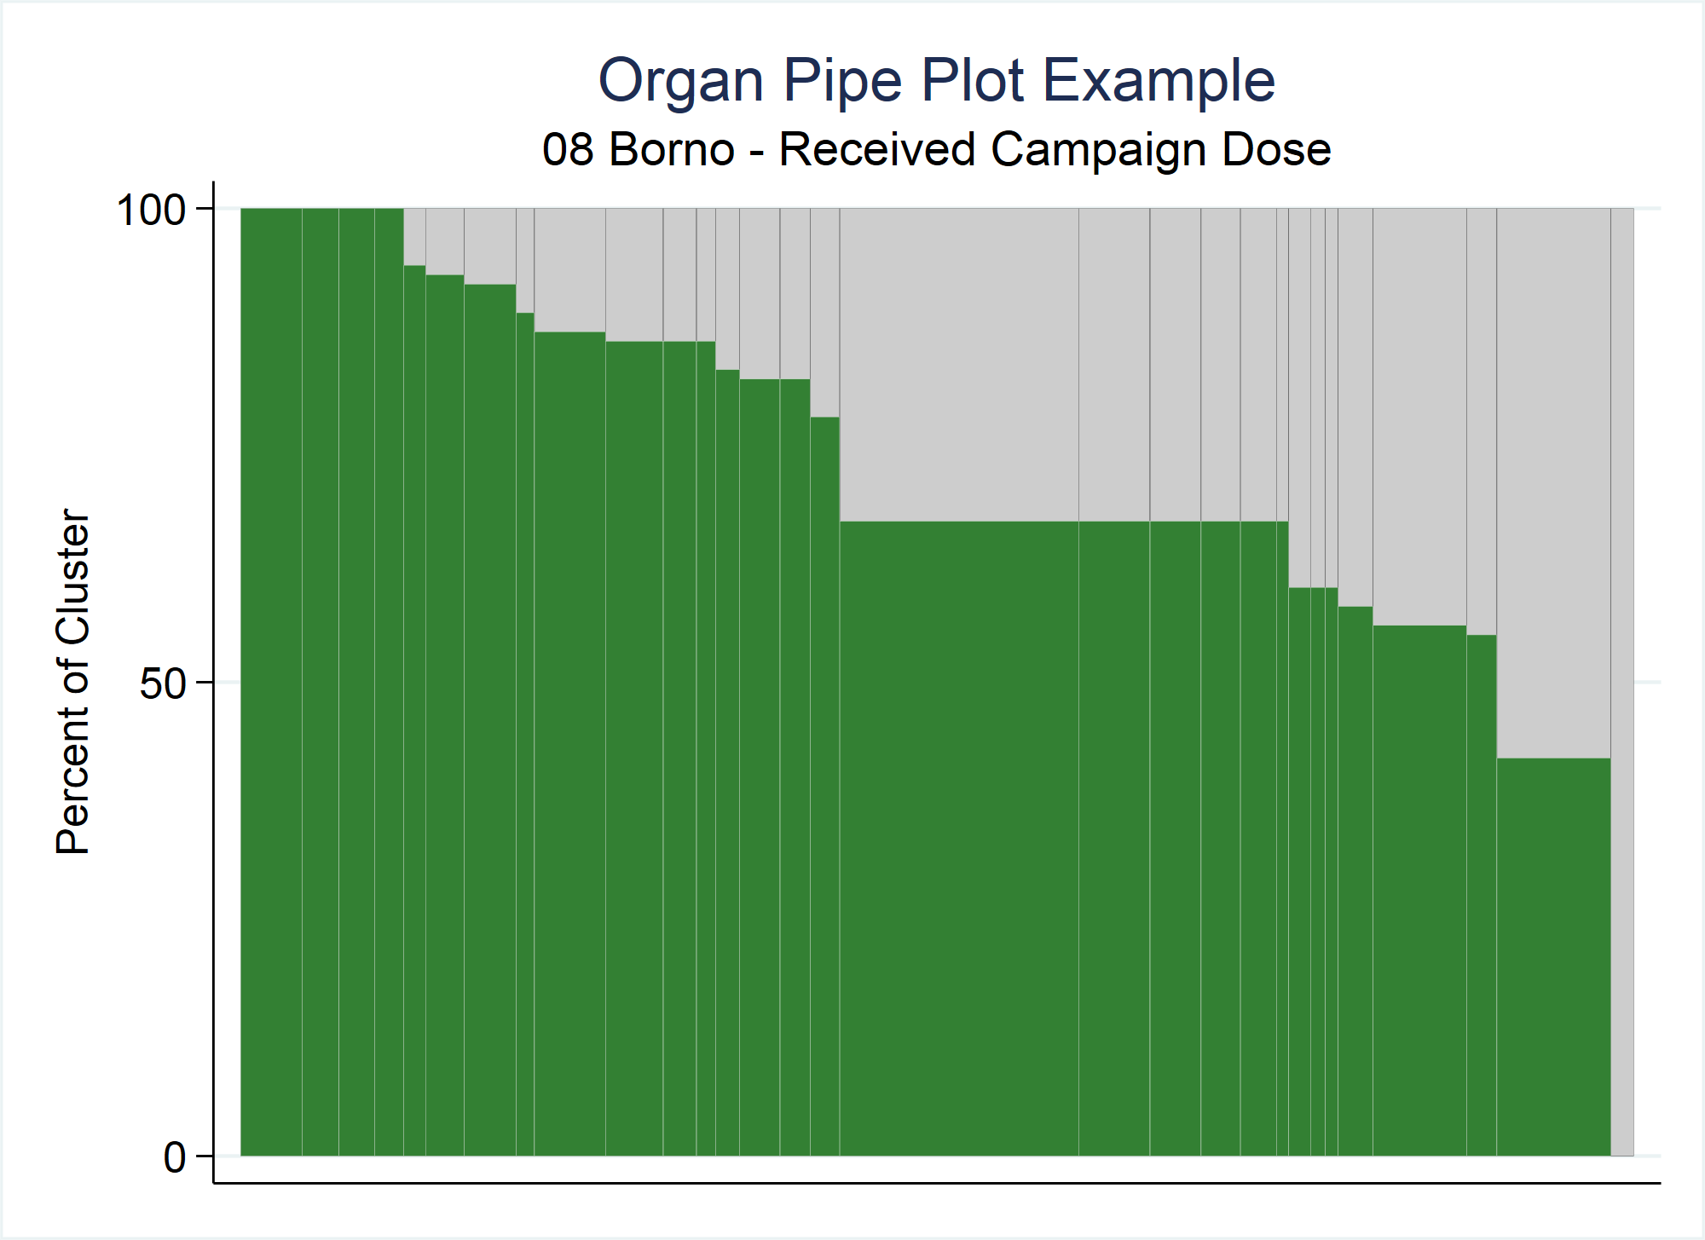
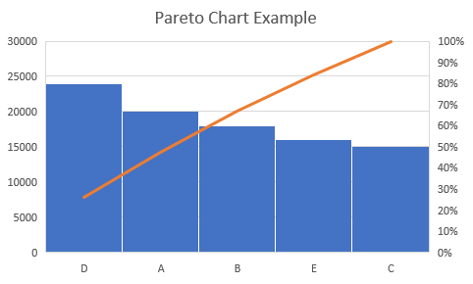
Organ Pipe Plots are not Pareto Charts
Both graphics sort bars in descending order
Pareto charts highlight important factor(s) among a large group of factors (often defects)
OP plots look for empty bars & shaded portion of the weighted plot is an estimate of vaccination coverage
Notes:
OP plots are not Pareto charts, which are commonly used in quality control studies.
Although both graphics sort bars in descending order, there are fundamental differences between the two.
Pareto charts highlight important factors among a large group of factors (often defects), and focus on the bars or categories on the left side of the chart to attribute failures to causes. They show category frequencies and a cumulative percentage line.
With OP WEIGHTED plots, we are interested in the overall proportion of the plot that is shaded (green in this example), as that represents an estimate of coverage in that stratum. Also, OP plots in the vaccination setting focus on the right side of the plot to spot clusters with surprisingly low coverage.
Superficially they may look similar but there is a different message…
Note: Stata has a Pareto dot plot as proposed by Wilkinson (2006) (command <pdplot> written by Nick Cox)

Slide 28
Visual Connection to the Intracluster Correlation Coefficient (ICC)
Due to time and budget constraints for household surveys, cluster sampling is usually preferred to simple random sampling
ICC is a measure of the correlation of responses within clusters
Ranges from [-1,1] but practically ranges from [0,1]
Surveyors have no control over the ICC -> it can only be estimated after the data have been collected
ICC affects the design effect (DEFF) -> affects sample size calculations -> affects CI widths
OP plot bar height variability is a visual representation of the ICC
Notes:
Due to time and budget constraints for household surveys, cluster sampling is usually preferred to simple random sampling.
When this happens, responses within a cluster are likely to be more correlated than if the responses were chosen at random.
ICC is a measure of the correlation of responses within clusters.
Ranges from [-1,1] but practically in our line of work it ranges from [0,1] -> Values near 0 imply responses are not correlated whereas values near 1 imply responses are very correlated
Surveyors have no control over the ICC -> it can only be estimated after the data have been collected
In the beginning stages of survey planning, you need to estimate the ICC.
There is a domino affect -> the ICC affects the design effect (DEFF) which affects the sample size calculations which affect confidence interval widths.
Why is all of this important to this talk? The OP plot bar height variability is a visual representation of the ICC.

Slide 29
Notes:
Recall these OP plots from earlier…
4 strata -> 16 clusters -> sampled 16 respondents -> total of 256 respondents per stratum
50% coverage estimated for each stratum.
Let’s look at them individually…

Slide 30
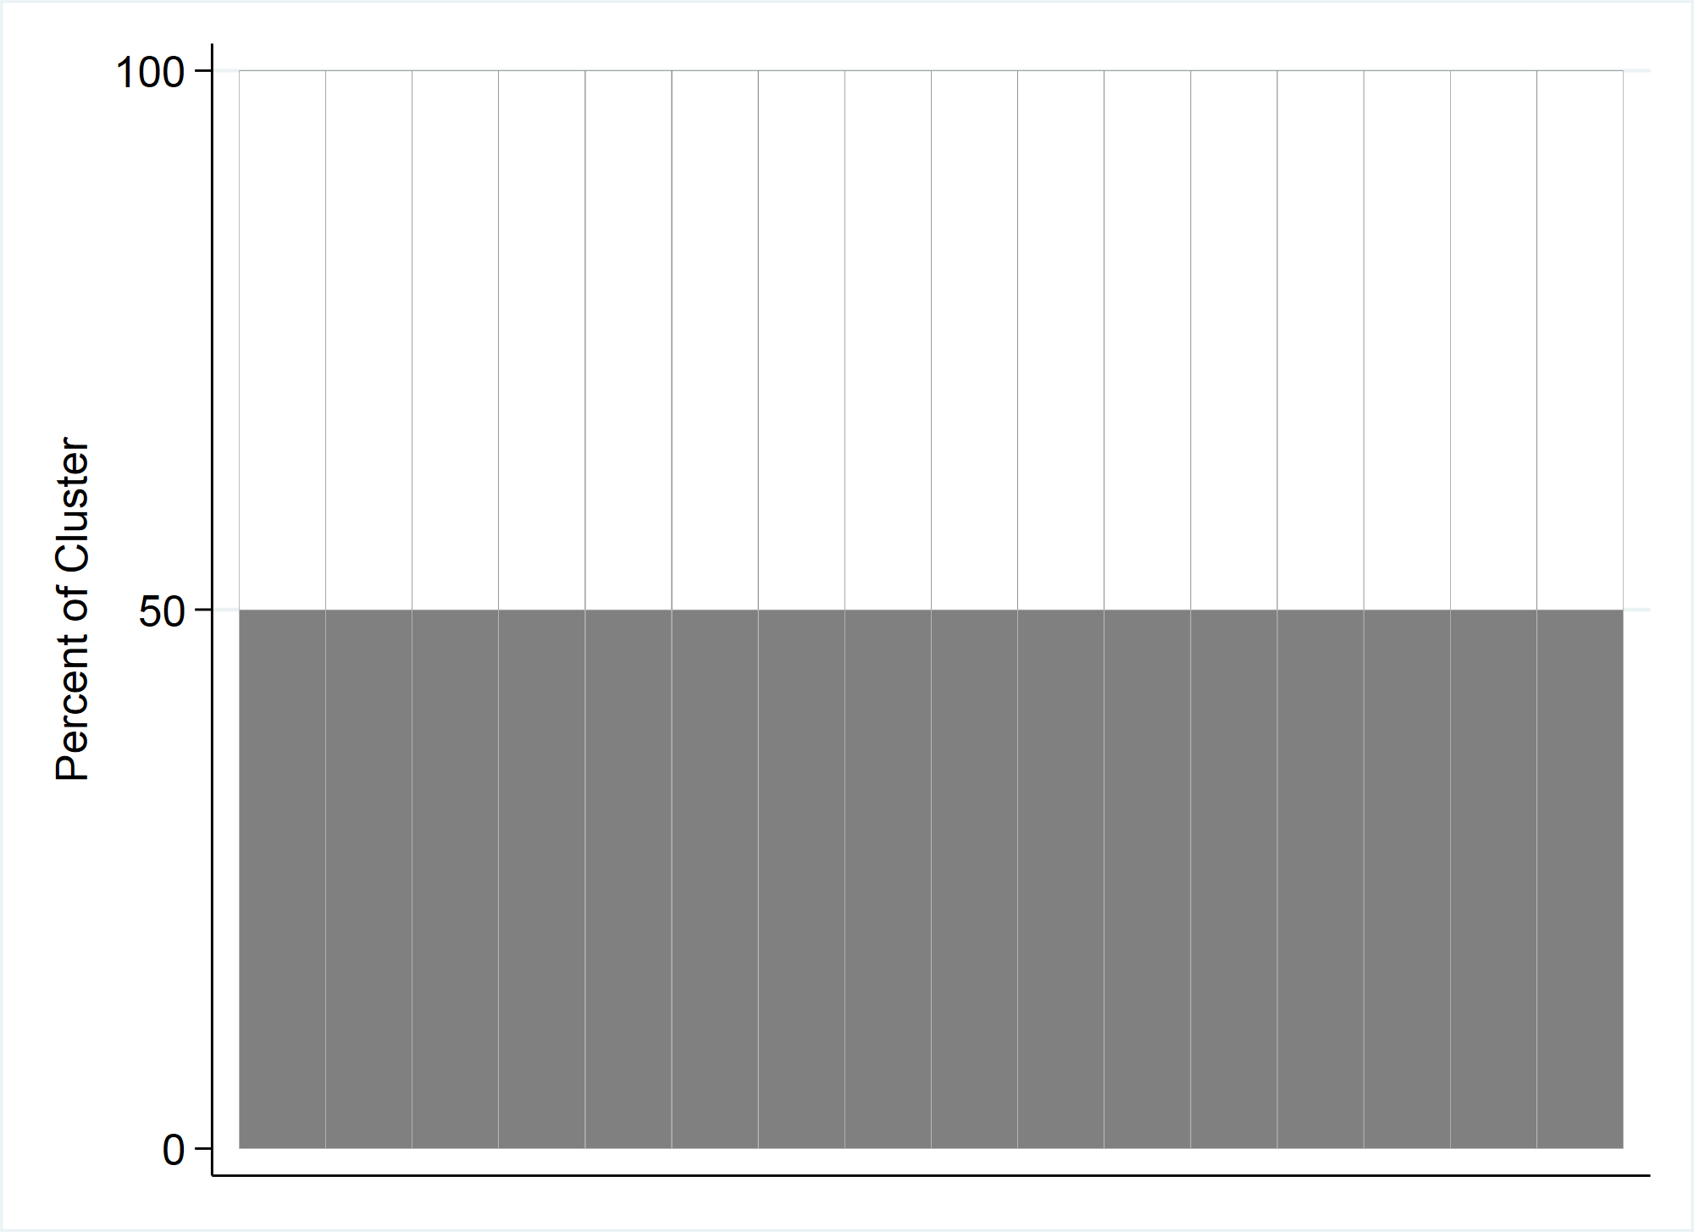
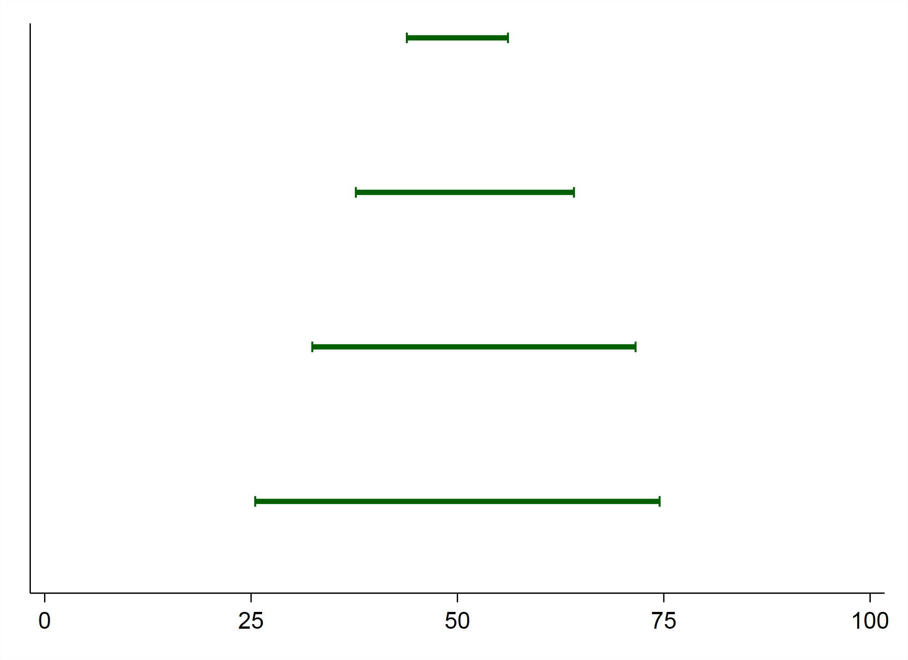
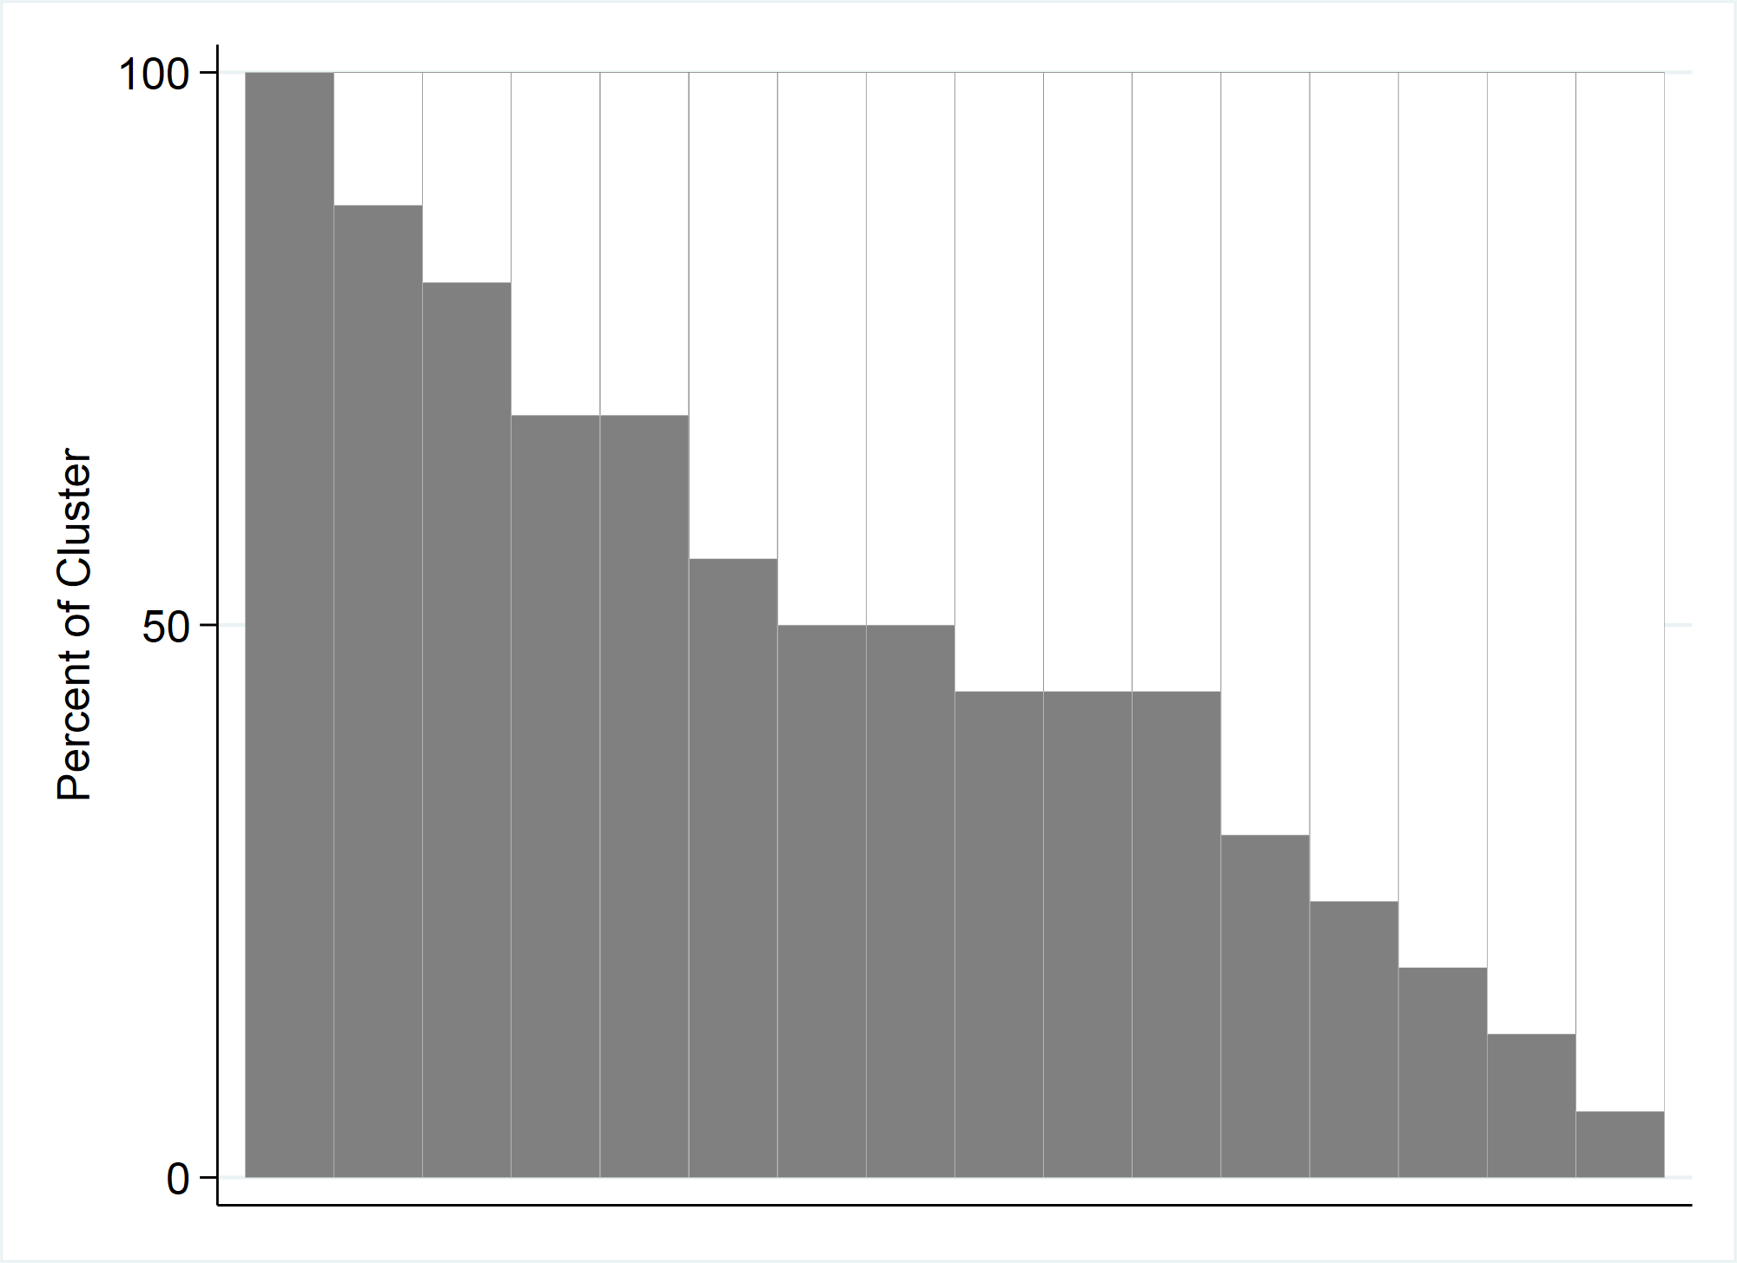
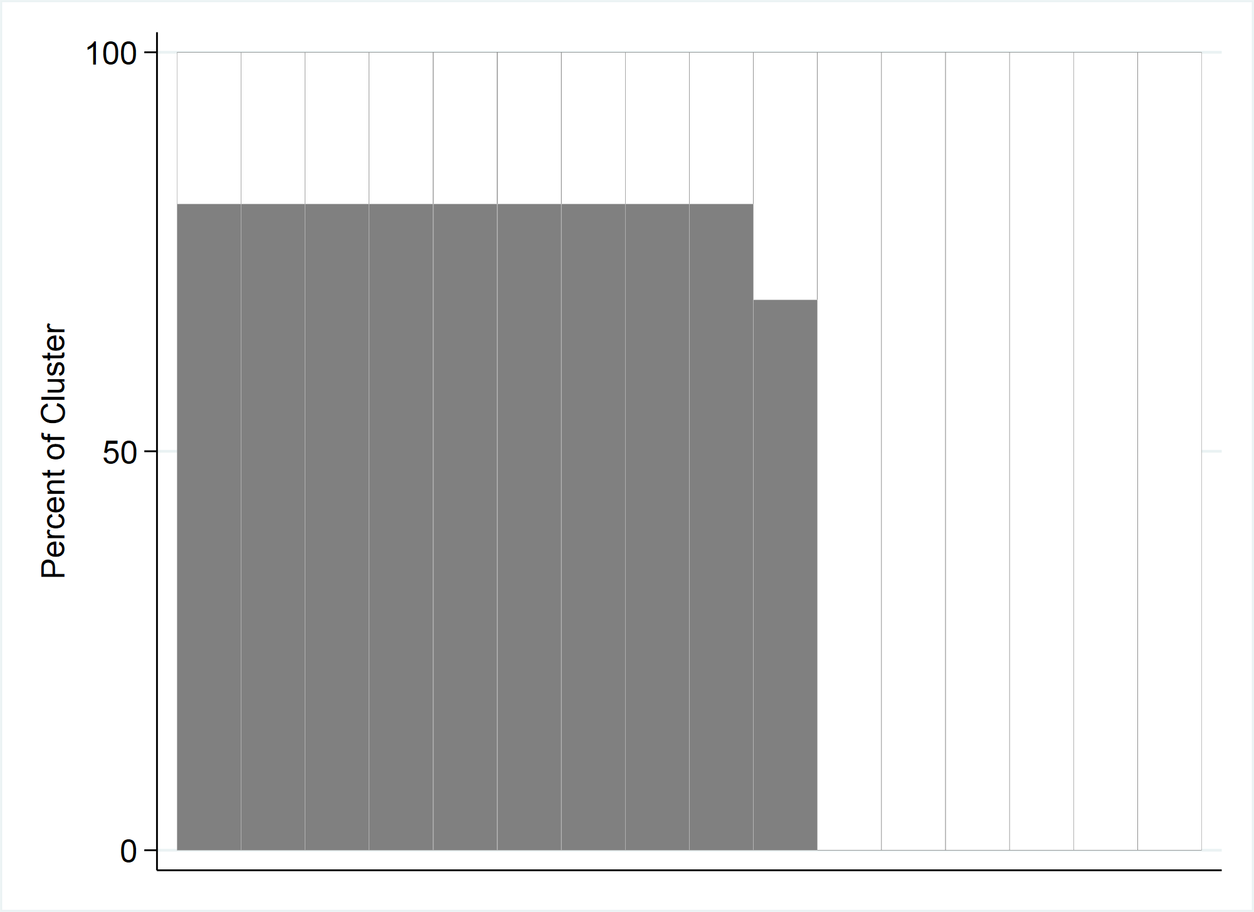
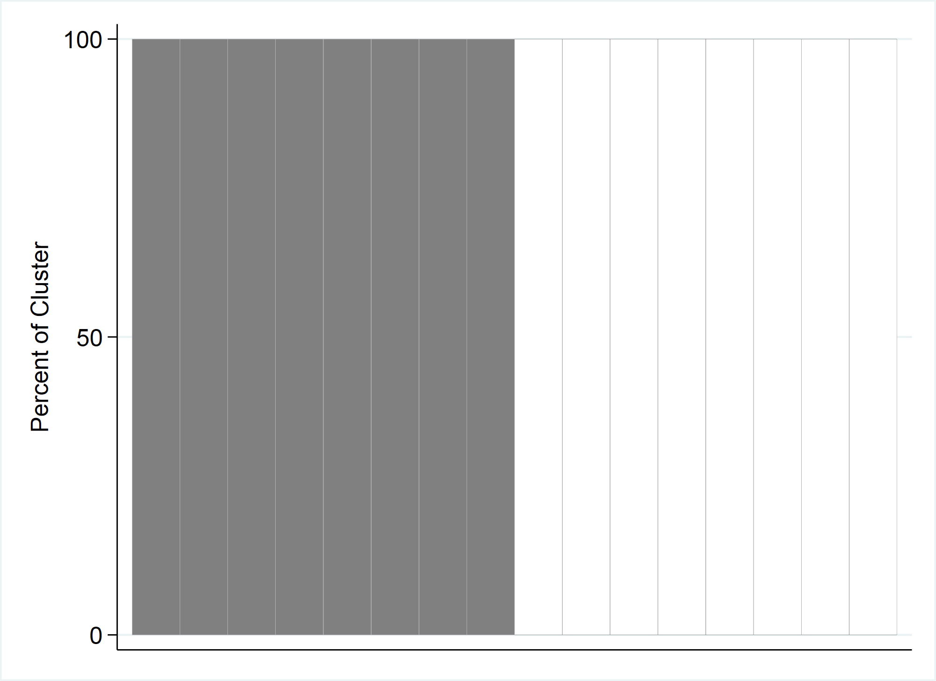
Visual Connection to the ICC
ESS = Effective Sample Size = N / DEFF
DEFF = Design Effect ≈ [1+ (m-1)*ICC]
where m is the avg # of respondents per cluster^
ICC = Intracluster Correlation Coefficient
N ESS DEFF ICC CI half width
256 256 1 0 6.1%
256 55 4.68 0.241 13.2%
256 25 10.26 0.593 19.6%
256 16 16 1 24.5%
^The avg # of respondents per cluster was m=16 for each stratum
Notes:
Although each stratum had the same number of respondents sampled, they all resulted in different CI widths because they all had different ICCs.
The top OP plot shows a stratum with homogeneous coverage -> ICC=0 -> DEFF=1 -> highest ESS possible-> tightest CI shown
Whereas the bottom OP plots shows a stratum at the other spectrum where some clusters have 100% coverage and other clusters have 0% -> ICC near 1 -> DEFF near maximum possible value…which is 16 in this case…the avg # of respondents per cluster (m) -> ESS is the lowest possible in this scenario…16 -> CI width is the largest possible in this scenario
The two plots in the middle show different patterns of coverage -> ICC ranges between 0 and 1 -> DEFF ranges between 1 and 16…average number of respondents per cluster -> CI widths will be between the two extremes.
***Extra notes***
Note that small values of ICC correspond to small values of DEFF (vice versa)
DEFF = [1+ (m-1)*ICC][1 + CV_{w}²] (not approximating DEFF; CV_{w} means coefficient of variation of the weights)

Slide 31
Visual Connection to the ICC Takeaways
Estimate the ICC with care because it impacts the CI width
OP plot bar height variability is a visual representation of the ICC that can help you picture the correlation in that stratum
Pay it forward…
Notes:
So…the visual connection to the ICC takeaways…
1. When planning a survey, you have estimate the ICC. If there was a previous similar survey conducted, then you could start with those estimates for your sample size calculations. If not, think hard about the expected correlation of responses within clusters of each stratum and estimate the ICC accordingly, knowing that that estimate will impact the CI width.
2. The OP plot bar height variability is a visual representation of the ICC that can help you picture the correlation in that stratum.
3. Pay it forward…after you finish your survey, make the OP plots and report the estimated ICC values, so that the next person (possibly you) planning the next survey has them as a baseline to start thinking about their ICC estimate for sample size calculations for their survey.

Slide 32
Organ Pipe Plots – Real World Use
2018 WHO Vaccination Coverage Cluster Surveys Reference Manual
WHO has developed a freely available Stata package named Vaccination Coverage Quality Indicators (VCQI)
Kenya Measles-Rubella Vaccination Campaign 2016 (paper published June 2018)
Jharkhand, India Measles Vaccination Campaign 2012 (paper published May 2015)
Notes:
I highlighted a few examples of where organ pipe plots have been used, and here are a few more, including the 2018 WHO Vaccination Coverage cluster surveys reference manual and the WHO suite of Stata programs named vaccination coverage quality indicators (VCQI).

Slide 33
Where Do I Find It?
Today: Link to our GitHub page here: www.biostatglobal.com
Soon: Find it on SSC

Slide 34
Questions?
Dale.Rhoda@biostatglobal.com
Mary.Prier@biostatglobal.com
Link to GitHub:
www.biostatglobal.com

Slide 35
Back-up slides…

Slide 36
Organ Pipe Plot – Bar Shading & Widths
 | Self-Weighted Data | Weighted Data (specify WEIGHTvar option) | Equal Bar Widths* (specify EQUALWIDTH option)
Shaded proportion of the bar (cluster) represents… | Proportion of respondents in that cluster whose value of yvar is equal to 1 | Proportion of respondents in that cluster whose value of yvar is equal to 1 | Proportion of respondents in that cluster whose value of yvar is equal to 1
Shaded proportion of the plot represents… | Sample coverage | Weighted sample coverage (Estimated population coverage) | Nothing
Bar widths represent… | Sample proportion represented by each cluster | Weighted proportion of population represented by each cluster | Nothing
*Specifying equal bar widths is helpful if user wants to label each cluster/bar in the plot

Slide 37
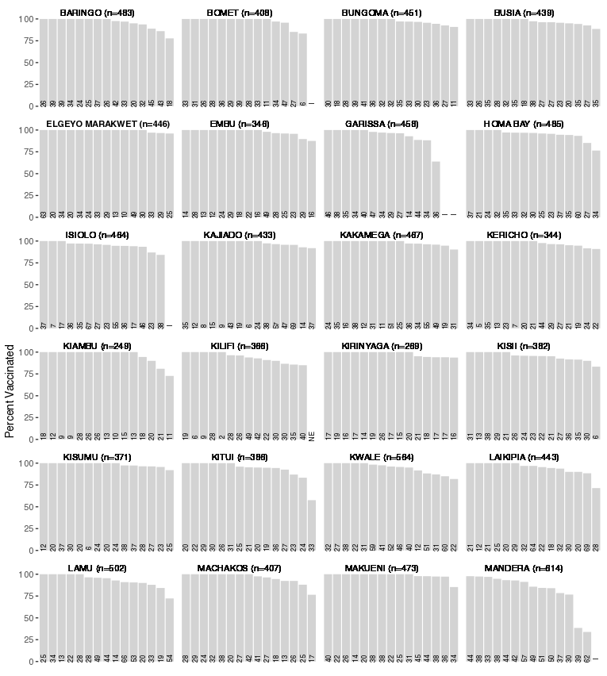
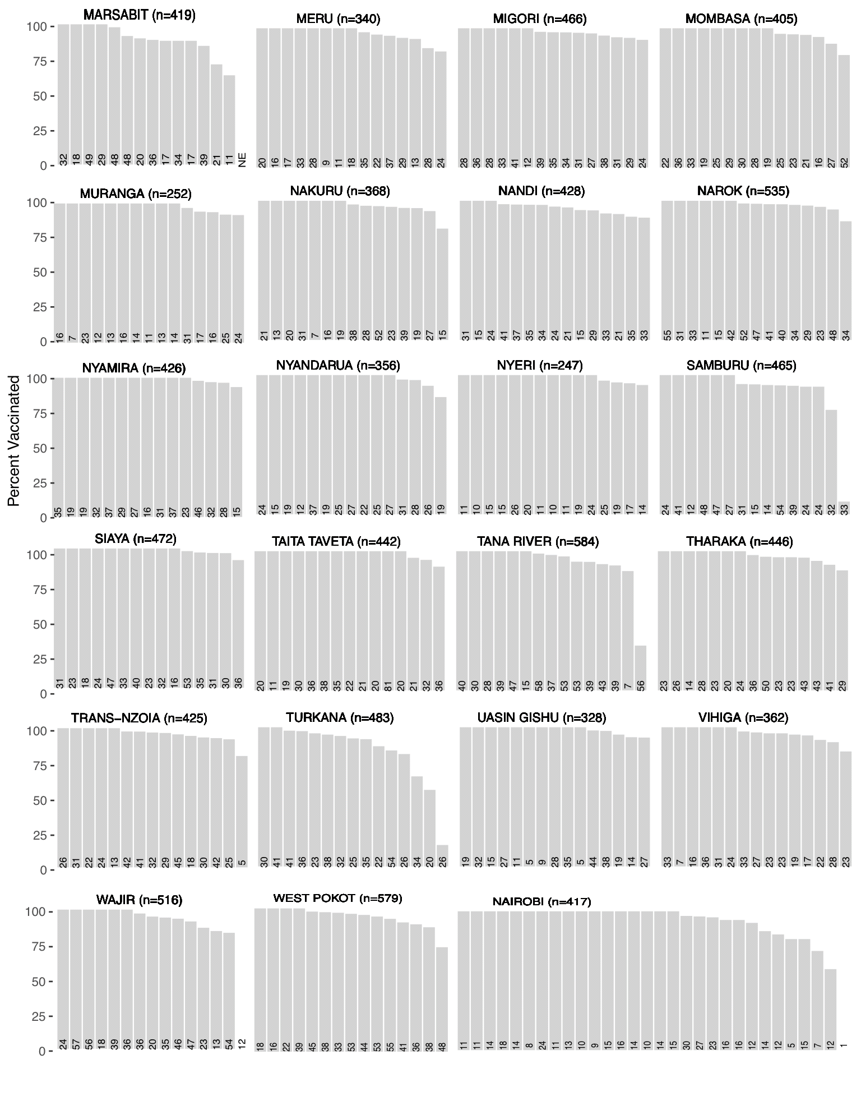
Kenya Measles Vaccination Campaign 2016
Notes:
Example of plots that used equal widths and annotated with sample size
Note: The idea of OP plot was used but the command opplot was not used to generate these plots. These plots just illustrate equal widths and the use of labelling the bars.
Fig S1. Organ-pipe plots of unweighted measles-rubella campaign vaccination coverage by cluster and county
— Kenya 2016 (14). For each cluster, the total number of eligible children aged 9 months–14 years that were
enrolled in the survey is printed at the bottom of the bar.

Slide 38
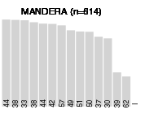
Kenya Measles Vaccination Campaign 2016
Notes:
One OP plot from the previous slide…zoomed in

